Slide 1

Maximum & Minimum Applied Electronics Example 1
RCET 0264 Introductory Calculus
Tim Leishman

Slide 2

Maximum & Minimum
The power in watts in a circuit with resistance in ohms varies according to $P=\frac{36R}{{(R+4)}^{2}}$ . Find the resistance that gives maximum power.

Slide 3


Maximum & Minimum
The power in watts in a circuit with resistance in ohms varies according to $P=\frac{36R}{{(R+4)}^{2}}$ . Find the resistance that gives maximum power.
$$P=\frac{36R}{{(R+4)}^{2}}$$
$\frac{dp}{dr}=\frac{36 {(R+4)}^{2}−(1)(2)(R+4)(36R) }{{(R+4)}^{4}}$
$0=\frac{36 {(R+4)}^{2}−(1)(2)(R+4)(36R) }{{(R+4)}^{4}}$
$0=\frac{36 {(R+4)}^{2}}{{(R+4)}^{4}} − \frac{(2)(R+4)(36R)}{{(R+4)}^{4}}$
$\frac{(2)(R+4)(36R)}{{(R+4)}^{4}}=\frac{36 {(R+4)}^{2}}{{(R+4)}^{4}}$
$(2)(R+4)(36R)$ = $36 {(R+4)}^{2}$
*Derivative using the Quotient rule!

Slide 4

Maximum & Minimum
The power in watts in a circuit with resistance in ohms varies according to $P=\frac{36R}{{(R+4)}^{2}}$ . Find the resistance that gives maximum power.
$(2)(R+4)(36R)$ = $36 {(R+4)}^{2}$
$(R+4)(72R)$ = $36 {(R+4)}^{2}$
$72R^{2}+288R$ = $36 {(R+4)}^{2}$
$72R^{2}+288R$ = $36(R^{2}+8R+16)$
$72R^{2}+288R$ = $36R^{2}+288R+576$
$72R^{2}+288R$ = $36R^{2}+288R+576$
$36R^{2}=576$
$R^{2}=16$
$R=4$

Slide 5
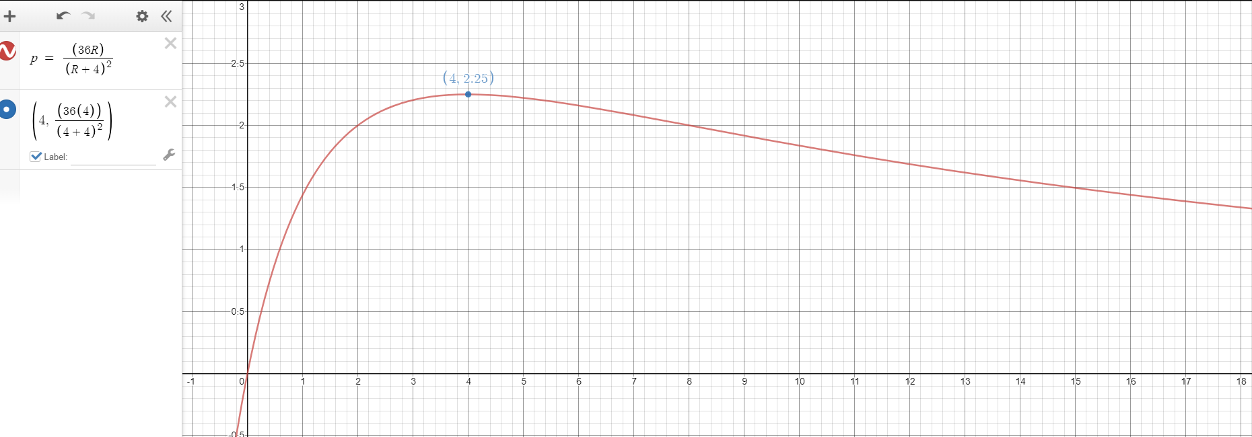


Maximum & Minimum
The power in watts in a circuit with resistance in ohms varies according to $P=\frac{36R}{{(R+4)}^{2}}$ . Find the resistance that gives maximum power.
$R=4Ω$
$P=2.25W$

Slide 6
Maximum & Minimum
References:
Ewen, D., Gary, J. S., & Trefzger, J. E. (2005). Technical calculus. Upper Saddle River, NJ: Pearson/Prentice Hall.
https://www.desmos.com
https://www.autodesk.com/products/fusion-360/overview

